Slide 1
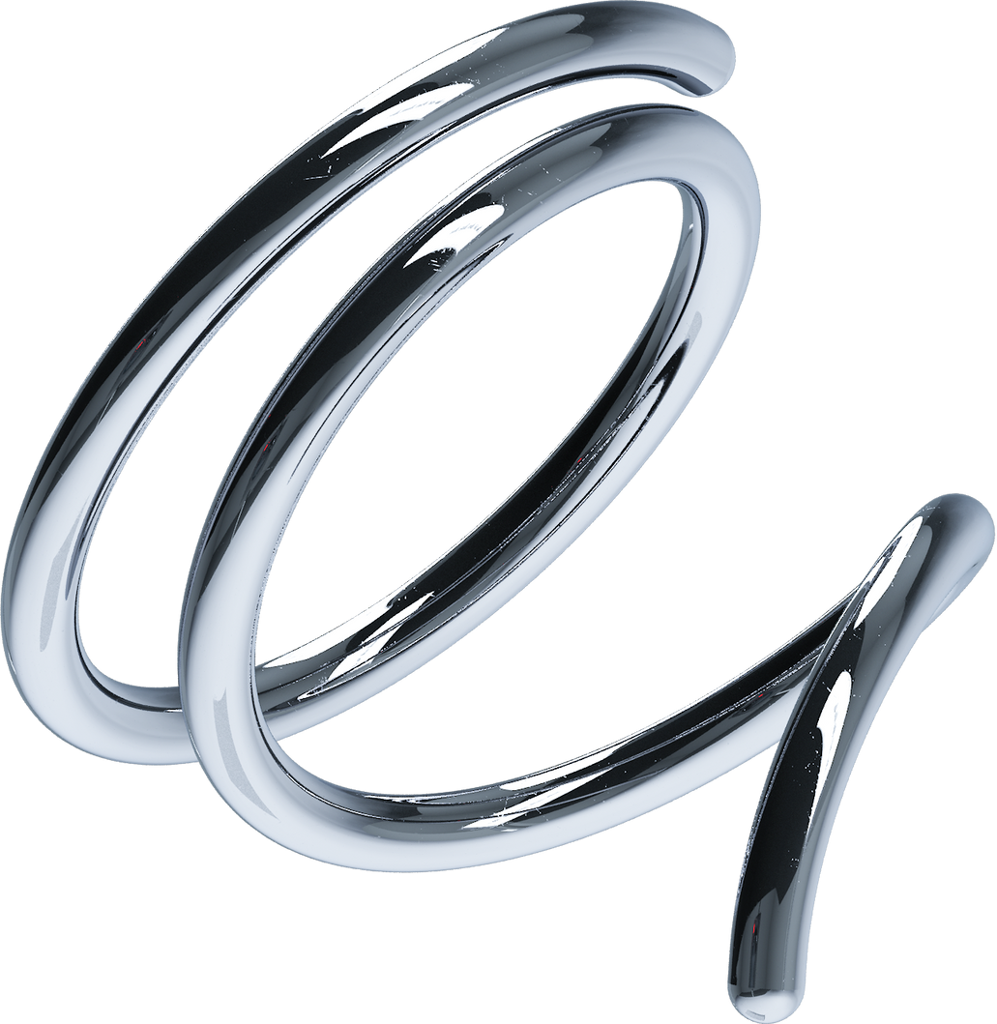
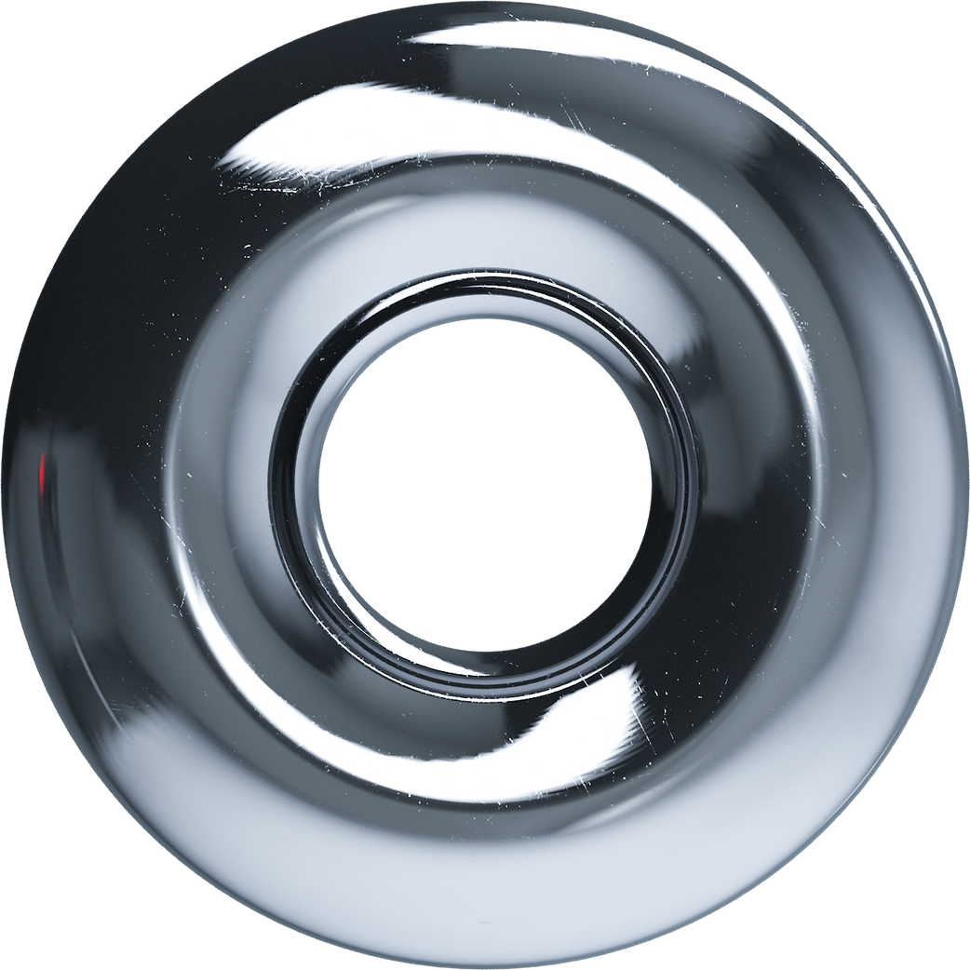
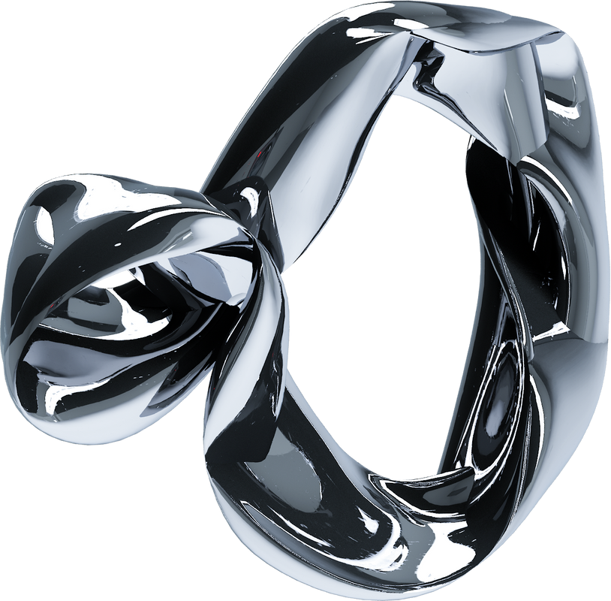


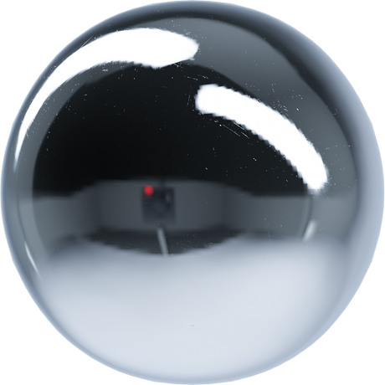
prepared by: Ababiya Tujuma
INSA

Slide 2
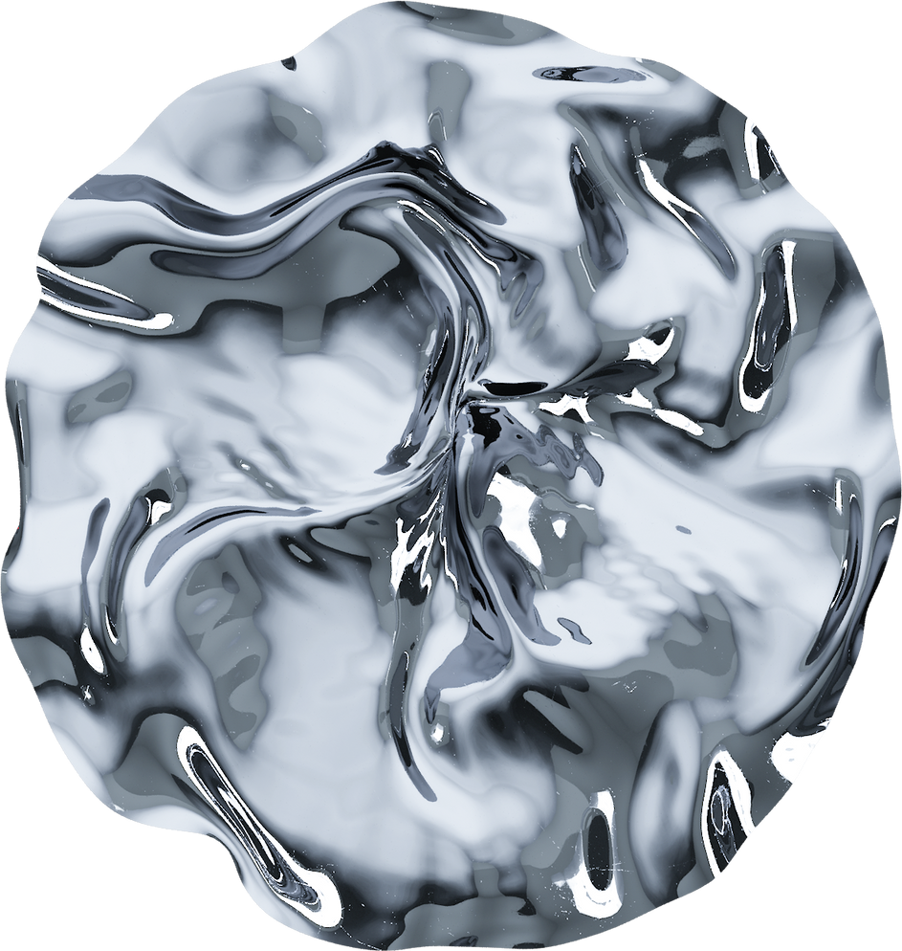
Outline
Active directory
Data center Infrastructure
DNS
OU
GPO
USER &COMPUTER
Domain replication
Hypervisor
Servers
Virtualization
traditional
converged
hyper converged

Slide 3
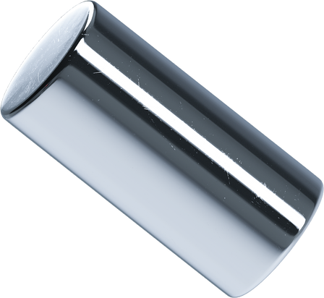
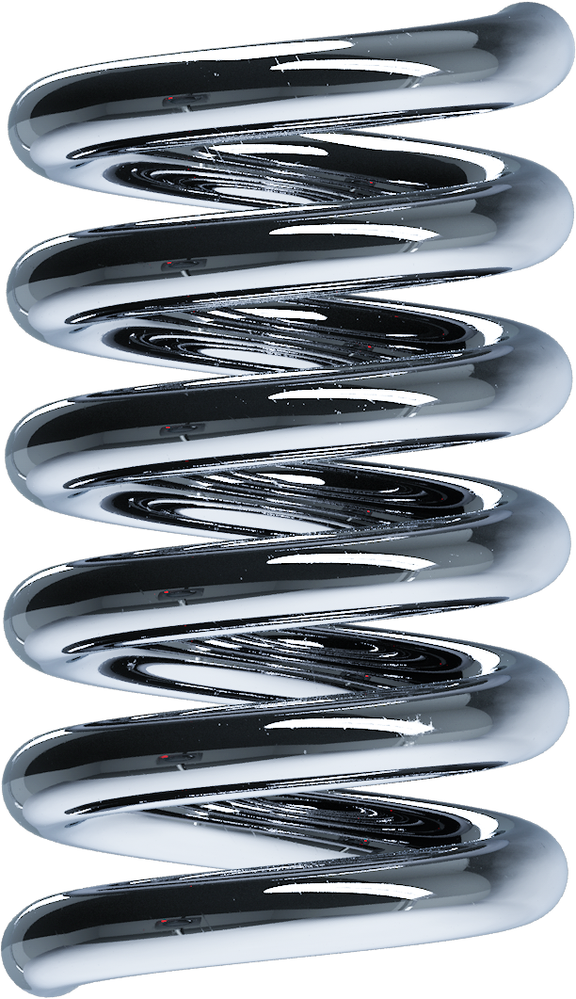
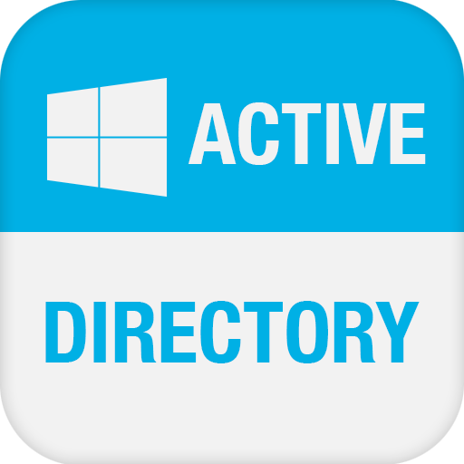
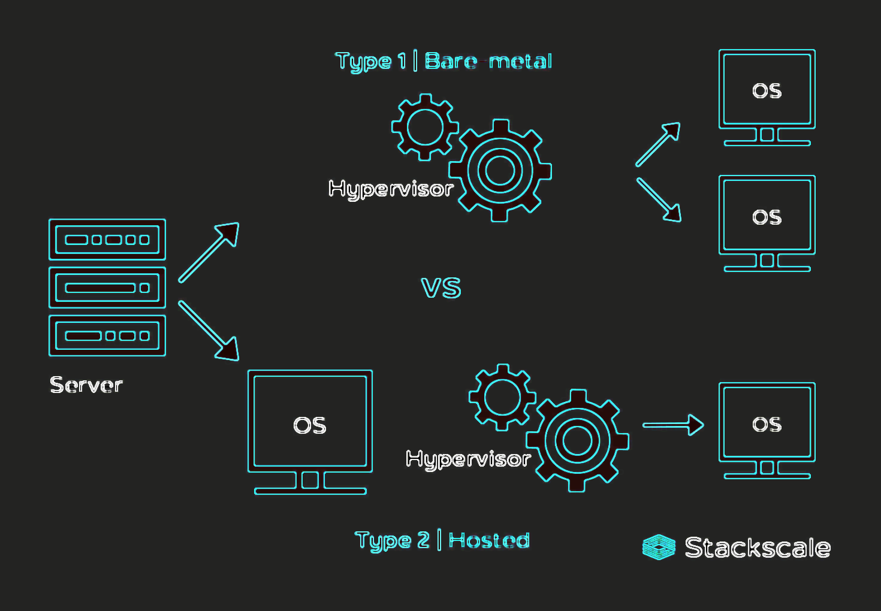

Category
01
02
03
Active directory
Hypervisors and
Servers
Data center Infrustructure

Slide 4
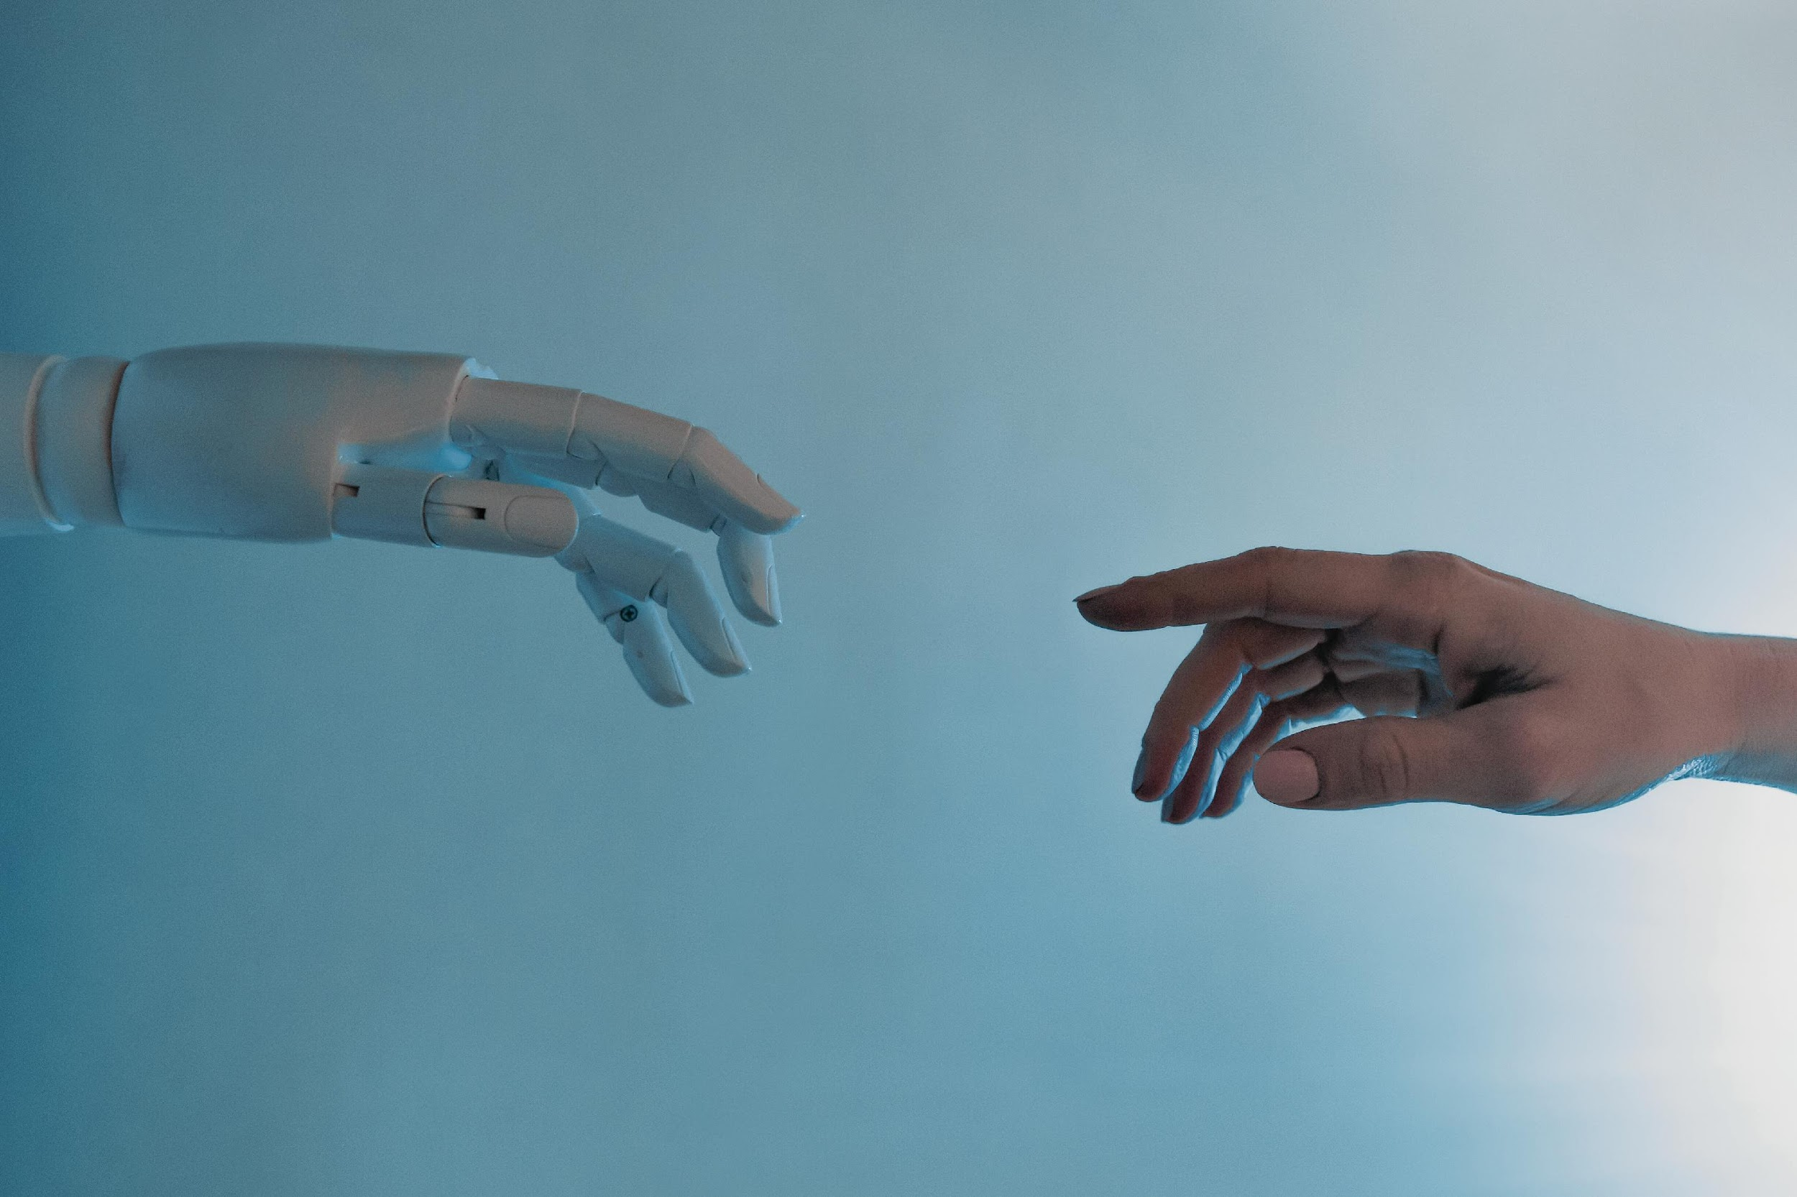
01
Active directory

Slide 5
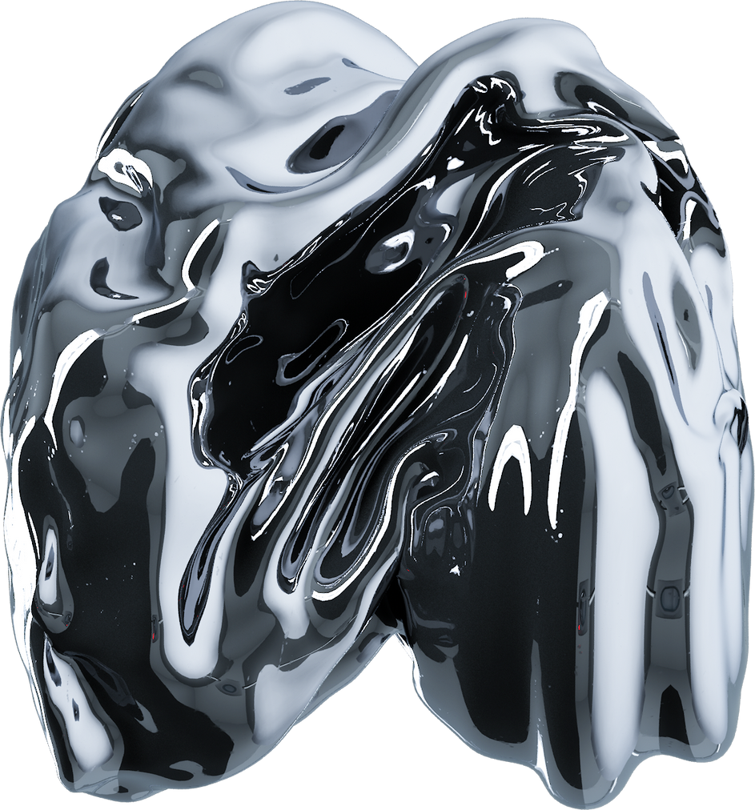
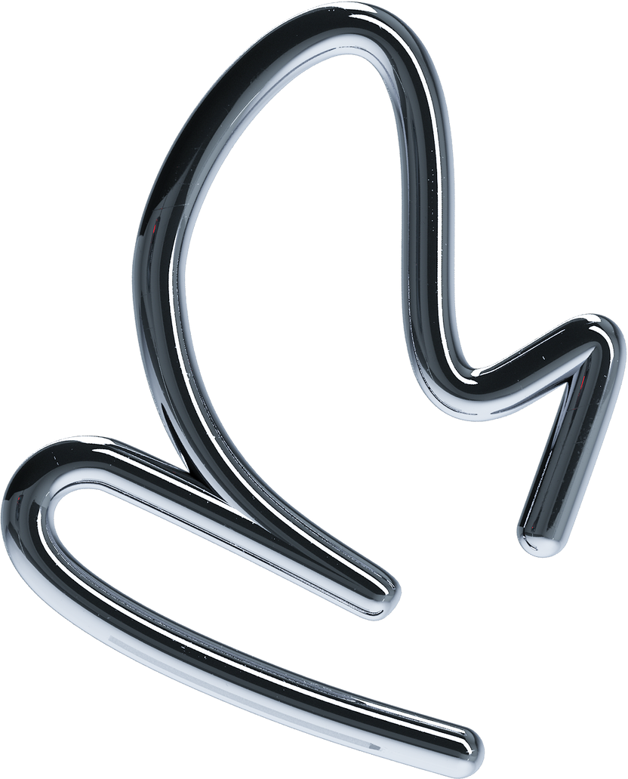
Active Directory stores information about objects on the network and makes this information easy for administrators and users to find and use.

Slide 6
Is a Microsoft directory service that provides Centralized authentication and authorization to network recourses.
Stores information about objects on the network and makes this information easy for administrators and users to find and use.
Uses a structured data store as the basis for a logical, hierarchical organization of directory information.

Slide 7
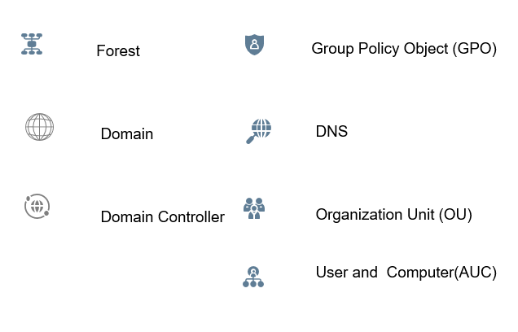
Components Of Active Directory

Slide 8
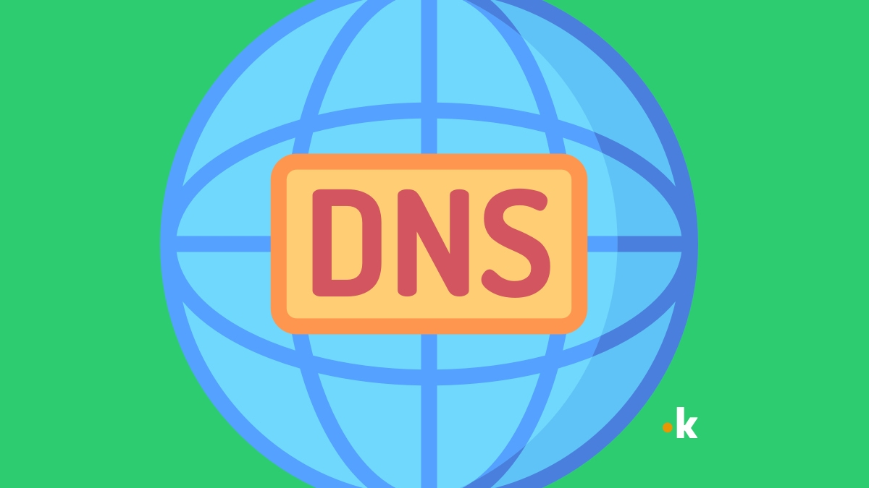
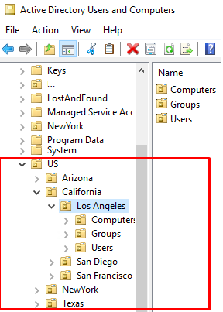
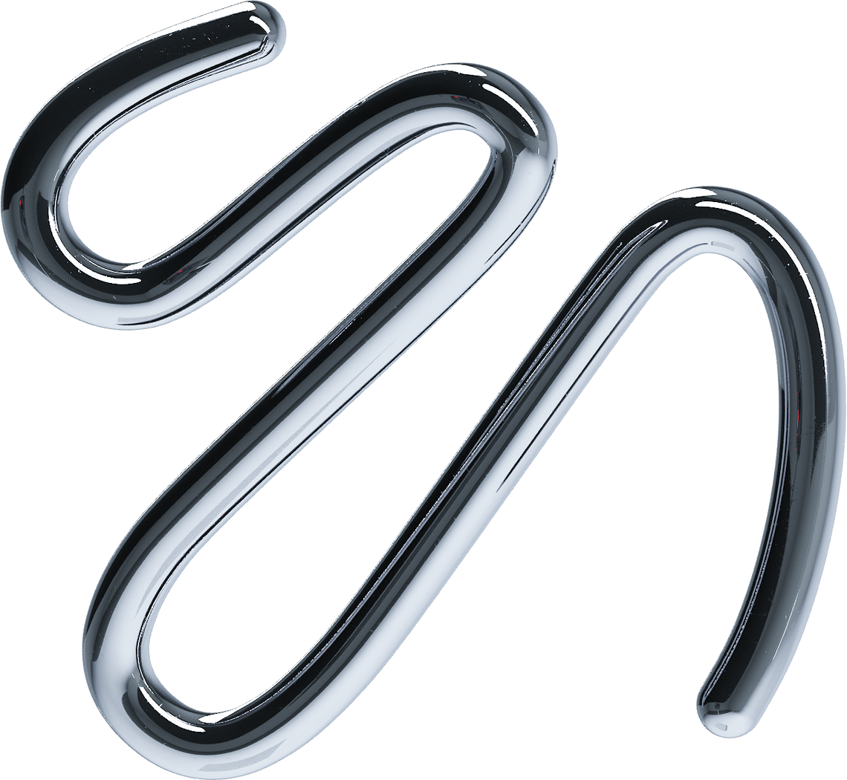
DNS
Active Directory Domain Services (AD DS) uses DNS as its domain controller location mechanism.
Domain controllers use DNS to locate each other.
DNS is part of the application layer of the TCP/IP reference model
Organizational Unit (OU)
OUs are used to organize AD objects into logical administrative containers.
The filesystem equivalent of OUs is folders.
OUs can be organized into a hierarchy.
structure and hierarchy of OUs reflects the functional (business structure) or physical divisions within an organization.

Slide 9
Group Policy Object (GPO)
Is a collection of Group Policy settings that defines what a system will look like and how it will behave for a defined group of users

Slide 10
Types of GPOs
Local Group Policy Objects
policy settings that only apply to the local computer and to the users who log on to that computer.
Non-local Group Policy Objects
used when policy settings have to apply to one or more Windows computers or users.
Starter Group Policy Objects
Introduced in Windows Server 2008, starter GPOs are templates for Group Policy settings.

Slide 11
Users and Computers
The Active Directory Users and Computers console is best known as a tool for user account creation and management
Also used to create and manage other types of Active Directory objects. These objects include groups, computers, contacts, printers, and shared folders.

Slide 12
Domain replication
Active Directory replication is the process by which the changes that originate on one domain controller are automatically transferred to other domain controllers that store the same data.

Slide 13

02
Hypervisor

Slide 14
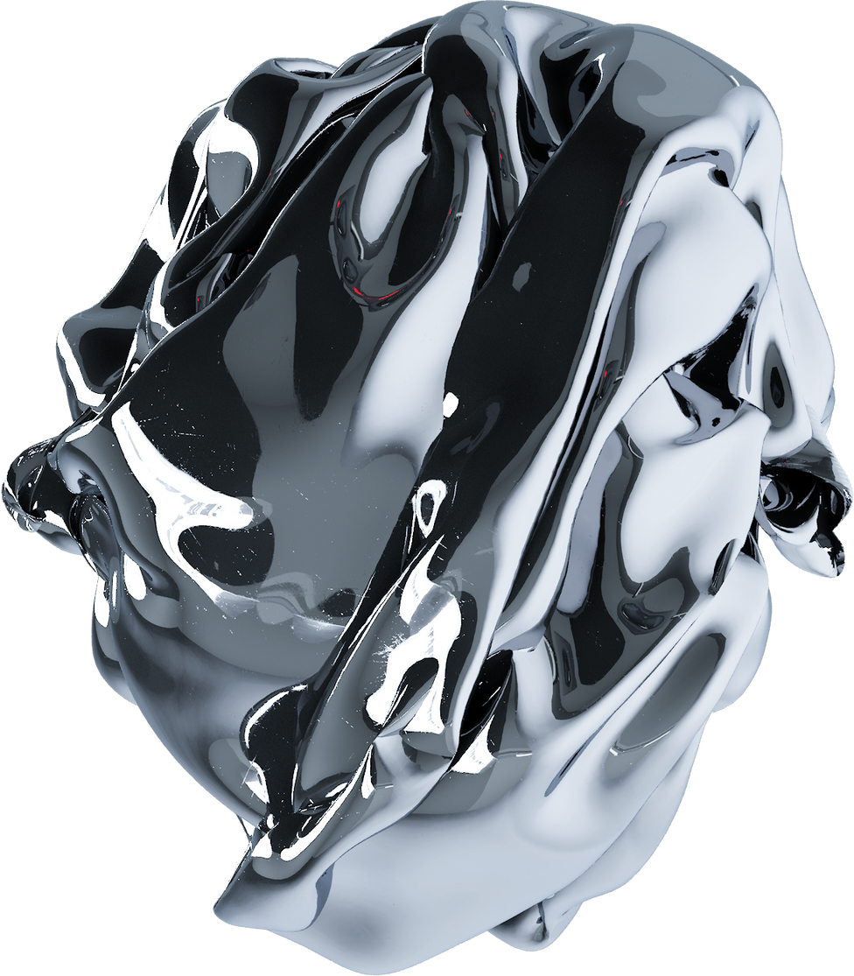
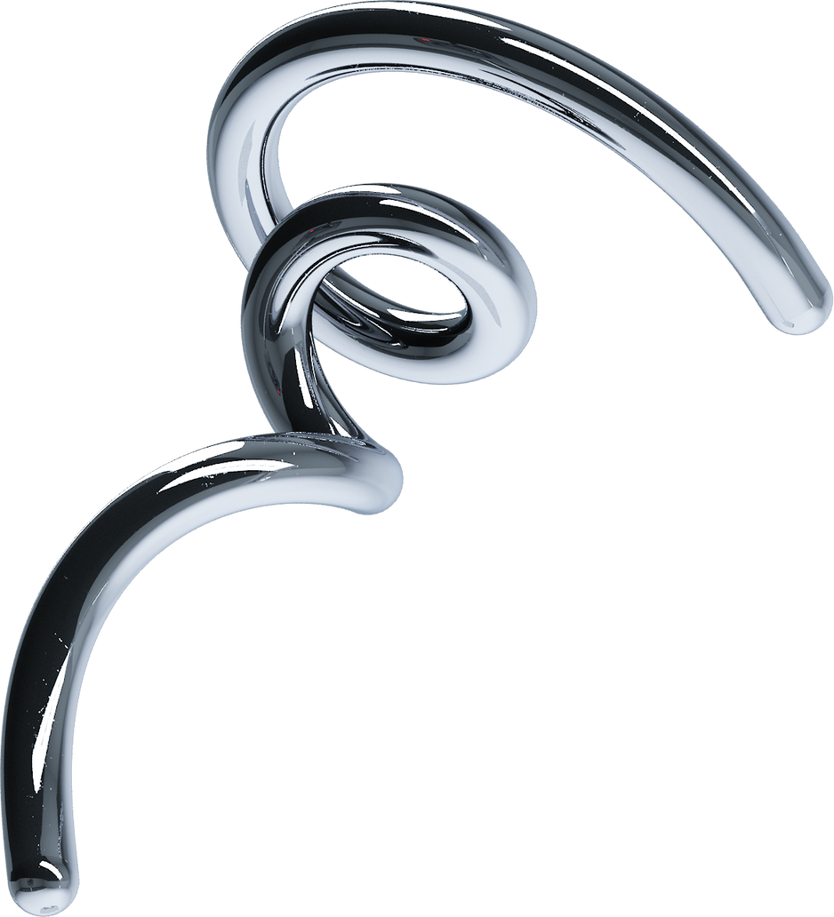
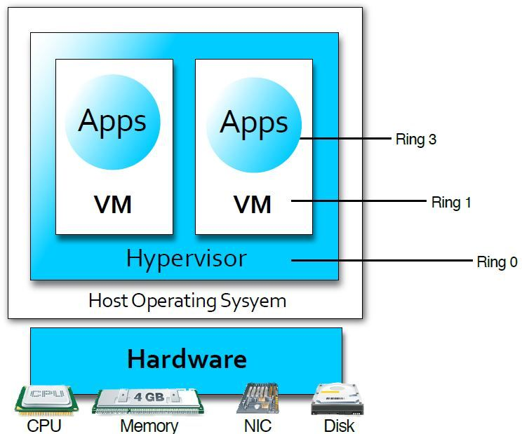
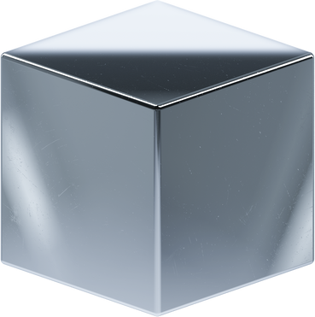
A hypervisor, also known as a virtual machine monitor or VMM
Is software that creates and runs virtual machines (VMs).
A hypervisor allows one host computer to support multiple guest VMs by virtually sharing its resources, such as memory and processing.

Slide 15
Types of Hypervisor
“Type 1” (or “bare metal”)
Acts like a lightweight operating system
Runs directly on the host’s hardware
“Type 2” (or “hosted”)
Runs as a software layer on an operating system

Slide 16
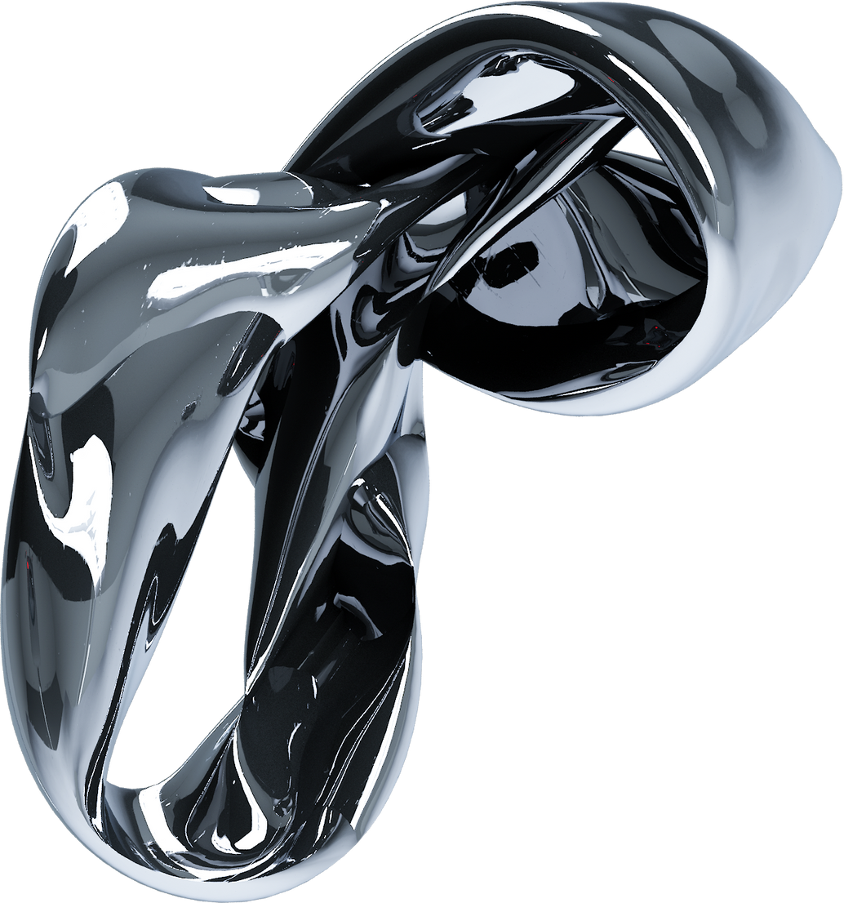
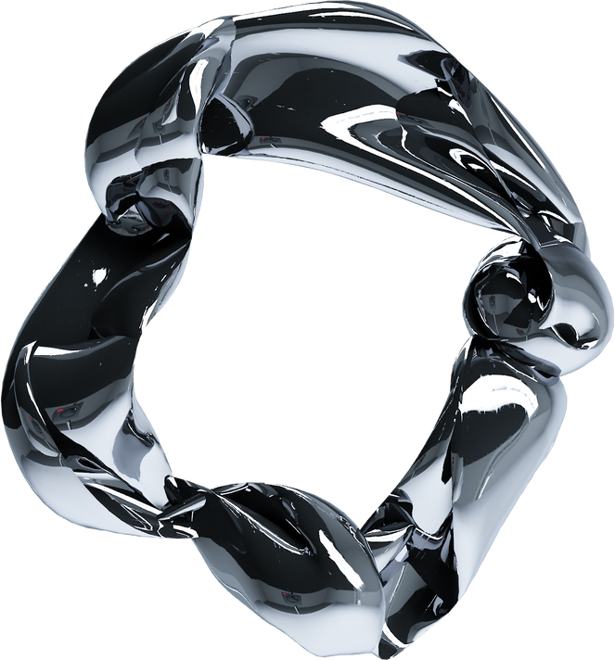
Servers
A server is a computer or system that provides resources, data, services, or programs to other computers, known as clients, over a network.

Slide 17
Major types of server hardware
Racks
Blades
mainframes

Slide 18
Types of Server
Web Servers
File Servers
Database Servers
Application Servers
Mail Servers
Print Servers
DNS Servers
Proxy Servers
FTP Servers
Game Servers
Virtual Servers
Chat Servers
Media Servers
Backup Servers
Security Servers
VoIP Servers
DHCP Servers
Time Servers
Remote Access Servers
IoT Servers

Slide 19
Virtualization
Is technology that you can use to create virtual representations of servers, storage, networks, and other physical machines.

Slide 20
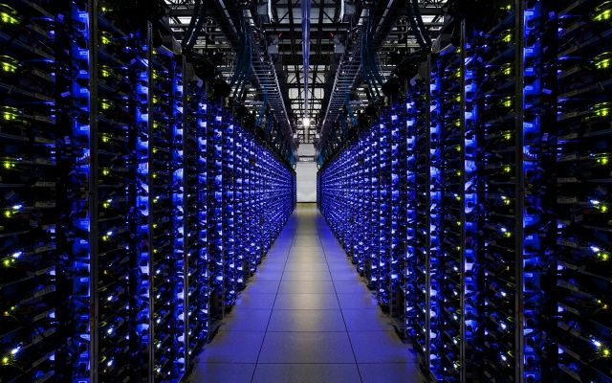
03
Data center Infrastructure

Slide 21
Traditional
Computer, storage and network components are physically distinct and managed separately from each other.

Slide 22
Converged
Computer, storage and network components are still physically distinct
Consolidated in a box
Managed from a single point

Slide 23
Hyper Converged
Brings computing, storage, and networking capabilities in a single unit.
Can not manage each component separately.
The system runs on a hypervisor.

Slide 24


